Slide 1

Final Year Project : Studying the effects of vision on balance

Slide 2
The hypothesis:
Affecting visual stimuli when a person sways, such that the sway of the stimuli is different from expected, should result in the person having difficulty to balancing.
Excessively affecting visual stimuli however, will have less or no effect on the person’s ability to balance

Slide 3
The core approach
Create a Virtual Reality Environment
Measure the sway of a user in real time
Manipulate the Virtual Reality Environment so that the visual input sways more than user is swaying

Slide 4
Measuring Sway
Force Plate
Measures centre of pressure
Can use a low pass filter to estimate centre of mass as well
Head set position
Measures centre of mass

Slide 5
Wiiboard Justification
Accuracy of force and center of pressure measures of the Wii Balance Board
Validity and reliability of the Nintendo Wii Fit Stillness score for assessment of standing balance
Validity of the Nintendo Wii® balance board for the assessment of standing balance in Parkinson’s disease
Comparison of a laboratory grade force platform with a Nintendo Wii Balance Board on measurement of postural control in single-leg stance balance tasks

Slide 6
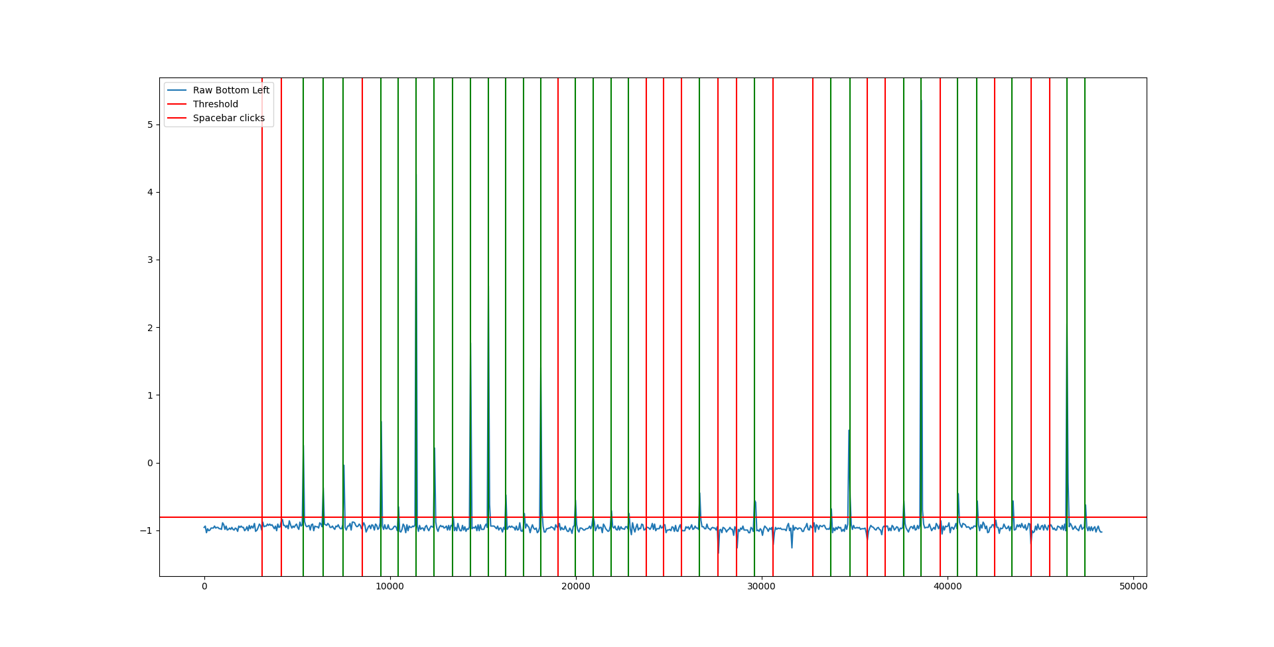
Wiiboard latency problem

Slide 7
Wiiboard connection problem
No solutions available to create a class in Unity to connect with my wiiboard
Either have to create a 3rd party software that communicates with Unity or create my own Wiimote C library
Local UDP Socket has 0.2ms latency

Slide 8






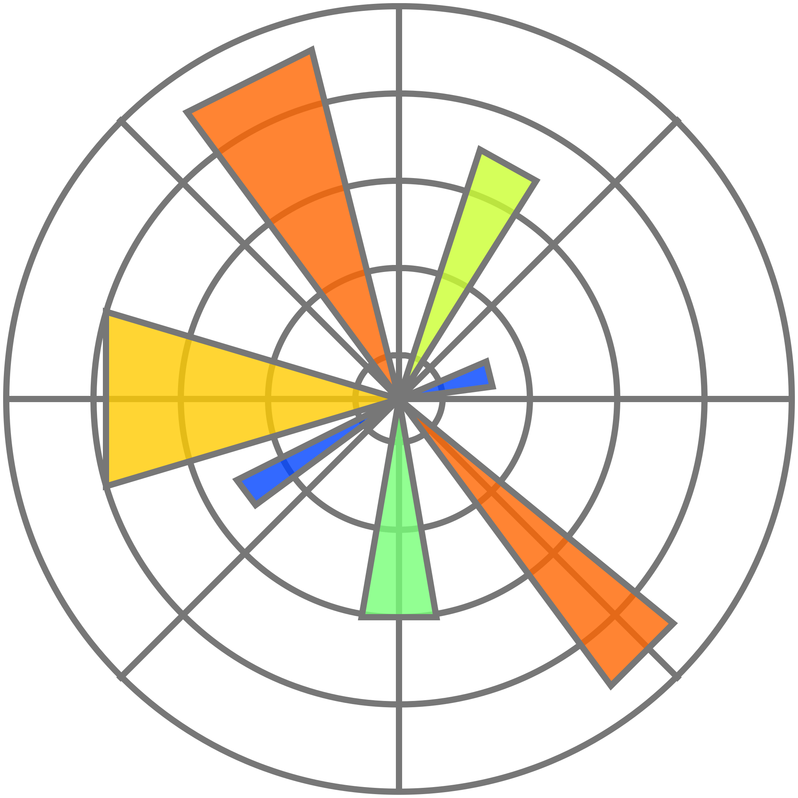
Key technologies
Unity project scene
UDP Socket with Wiimote Library
Python script
Bluetooth
C# UDP Socket
UDP Socket
Wiiboard
SteamVR Unity package
Pimax Virtual reality headset
PiTool
Matplotlib
Unity scripts
XR Interaction toolkit + OpenVR

Slide 9
Key technologies
Unity project scene
UDP Socket with Wiimote Library
Python script
Bluetooth
C# UDP Socket
UDP Socket
Wiiboard
SteamVR Unity package
Pimax Virtual reality headset
PiTool
Matplotlib
Unity scripts
XR Interaction toolkit + OpenVR

Slide 10

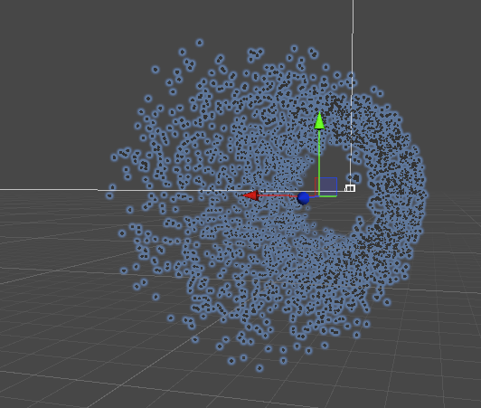
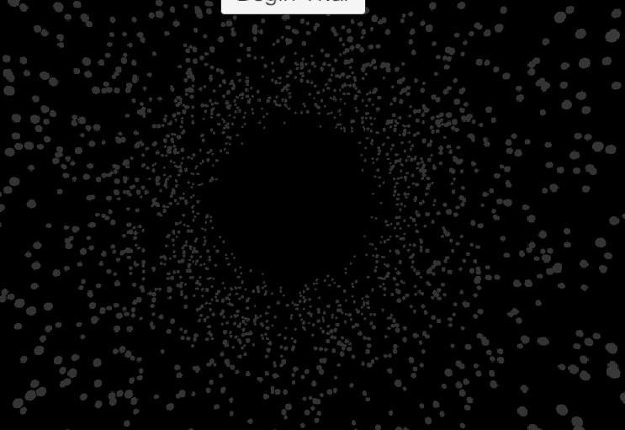
Choice of stimulus

Slide 11
Various Approaches to the Sway Problem
Moving the stimuli

Slide 12
What I learned
Choice of inputs – only need head input
Choice of stimuli – most of the information is not in FOV
Choice of motion, no angular motion and no parallax effect

Slide 13
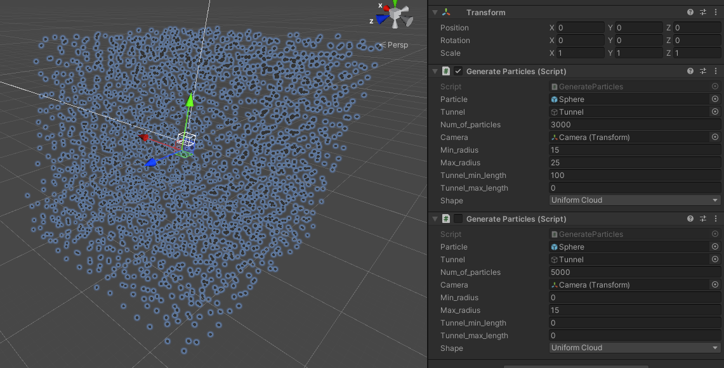
Choice of stimulus

Slide 14
Various Approaches to the Sway Problem
Inverse pendulum camera

Slide 15
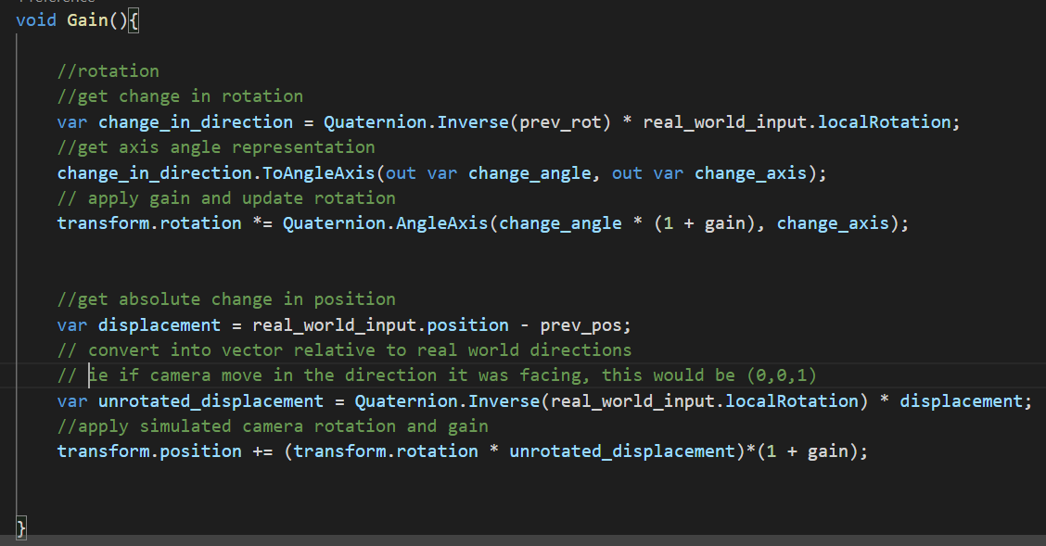
Various Approaches to the Sway Problem
2 parts:
Rotation
Get change in orientation of real – world input
Apply sensitivity
Apply to Simulated camera’s previous rotation
Position
Get Vector of displacement of real – world input
Apply inverse of real – world rotation
Apply Simulated camera’s rotation
Apply sensitivity
Apply to Simulated camera’s position
Changing camera based on VR headset orientation and position change

Slide 16
Demo!

Slide 17
Experiments
Each participant has 30s of “Control”, 60s of “Test” and 20s of “Aftermath”
Blue balance foam to slightly off balance user
Sensitivity settings: -0.5, 0.5, 1, 1.5, 1.75, 2
Each participant is asked to idly move their head
Order of sensitivity is different for every participant

Slide 18
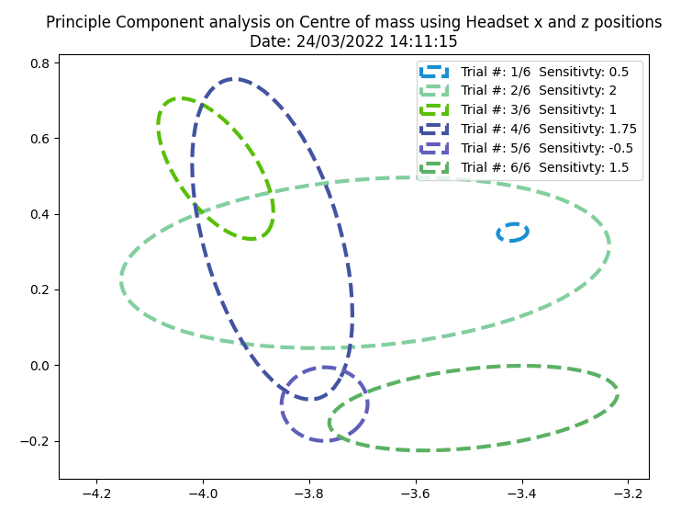
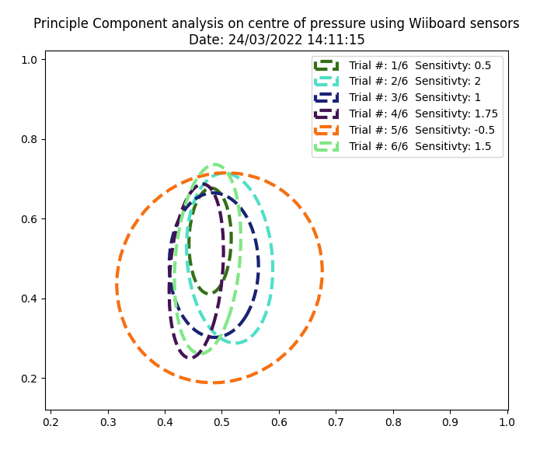
Experiments Results + analysis

Slide 19
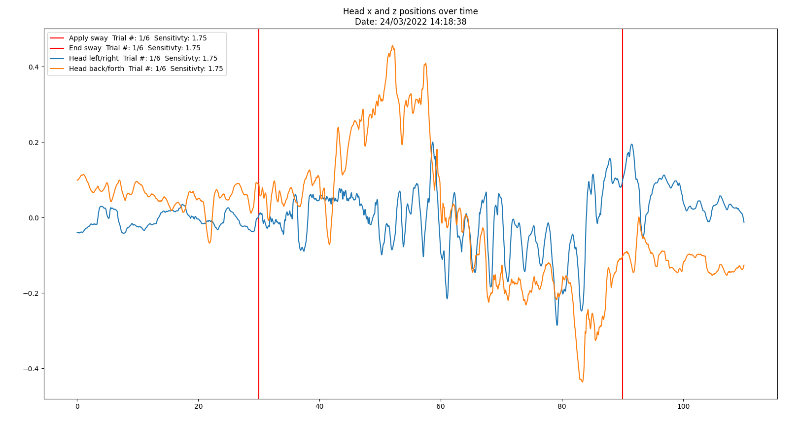
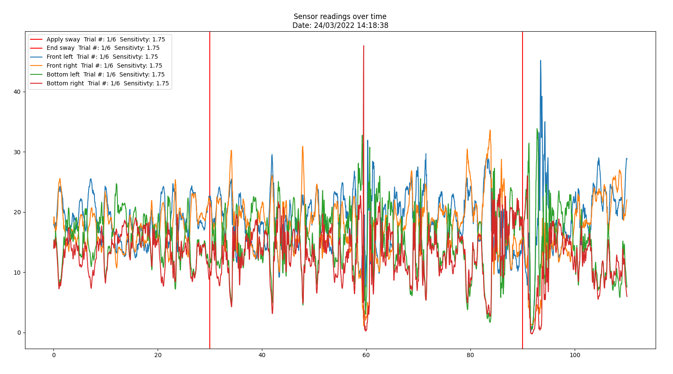
Experiments Results + analysis

Slide 20
Conclusion & Evaluation
Looks like there is a trend that supports the first part of the hypothesis
The experiments need to be tuned more – the users noted if they try particularly hard to balance or if they do not move their head it is quite easy to not get unbalanced
A key goal was to make solid documentation and legible code in order to allow this work to be continued

